Slide 1
Chapter 12
Entity-Relationship Modeling
Pearson Education © 2009

Slide 2
Chapter 12 - Objectives
How to use Entity–Relationship (ER) modeling in database design.
Basic concepts associated with ER model.
Diagrammatic technique for displaying ER model using Unified Modeling Language (UML).
How to identify and resolve problems with ER models called connection traps.
How to build an ER model from a requirements specification.
Pearson Education © 2009

Slide 3
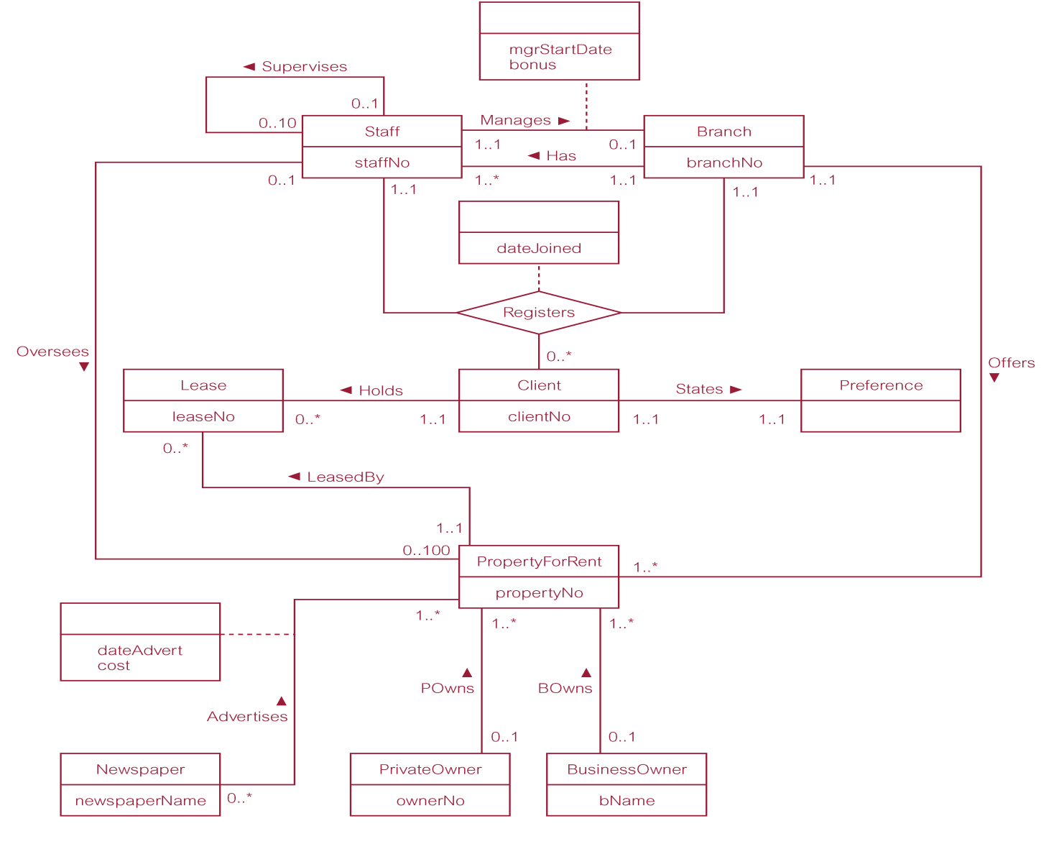
ER diagram of Branch user views of DreamHome
Pearson Education © 2009

Slide 4
Requirements
See p. 315 of Chapter 11 for the DreamHome database requirements.

Slide 5
Concepts of the ER Model
Entity types
Relationship types
Attributes
Pearson Education © 2009

Slide 6
Entity Type
Entity type
Group of objects with same properties, identified by enterprise as having an independent existence.
Entity occurrence
Uniquely identifiable object of an entity type.
Pearson Education © 2009

Slide 7
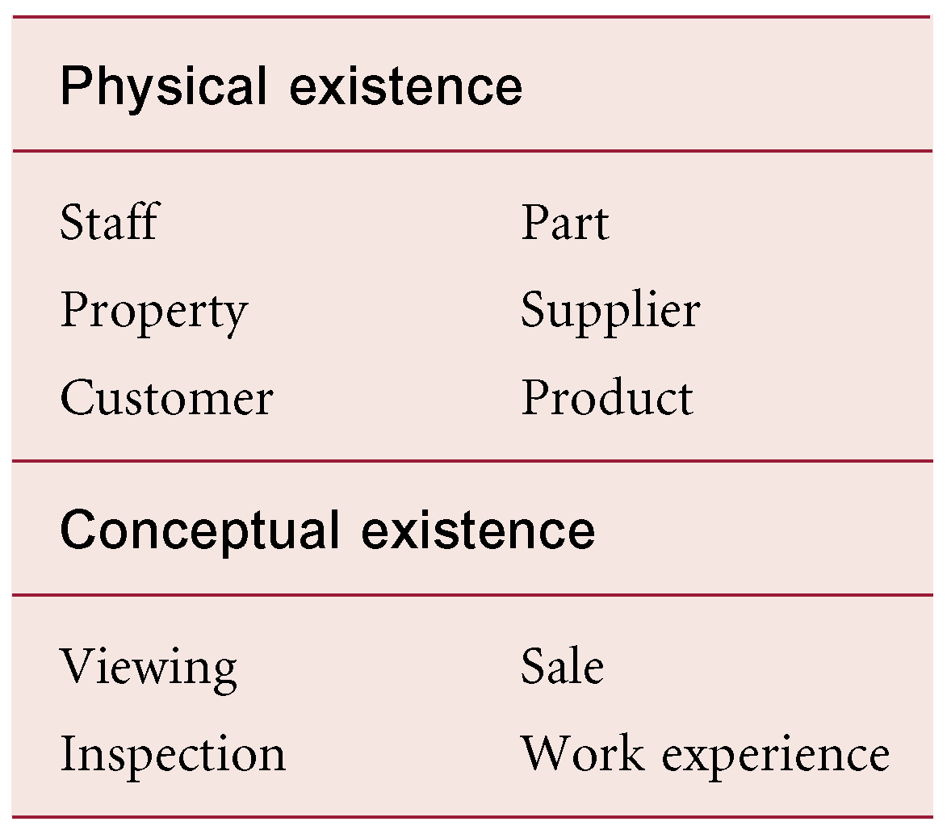
Examples of Entity Types
Pearson Education © 2009

Slide 8
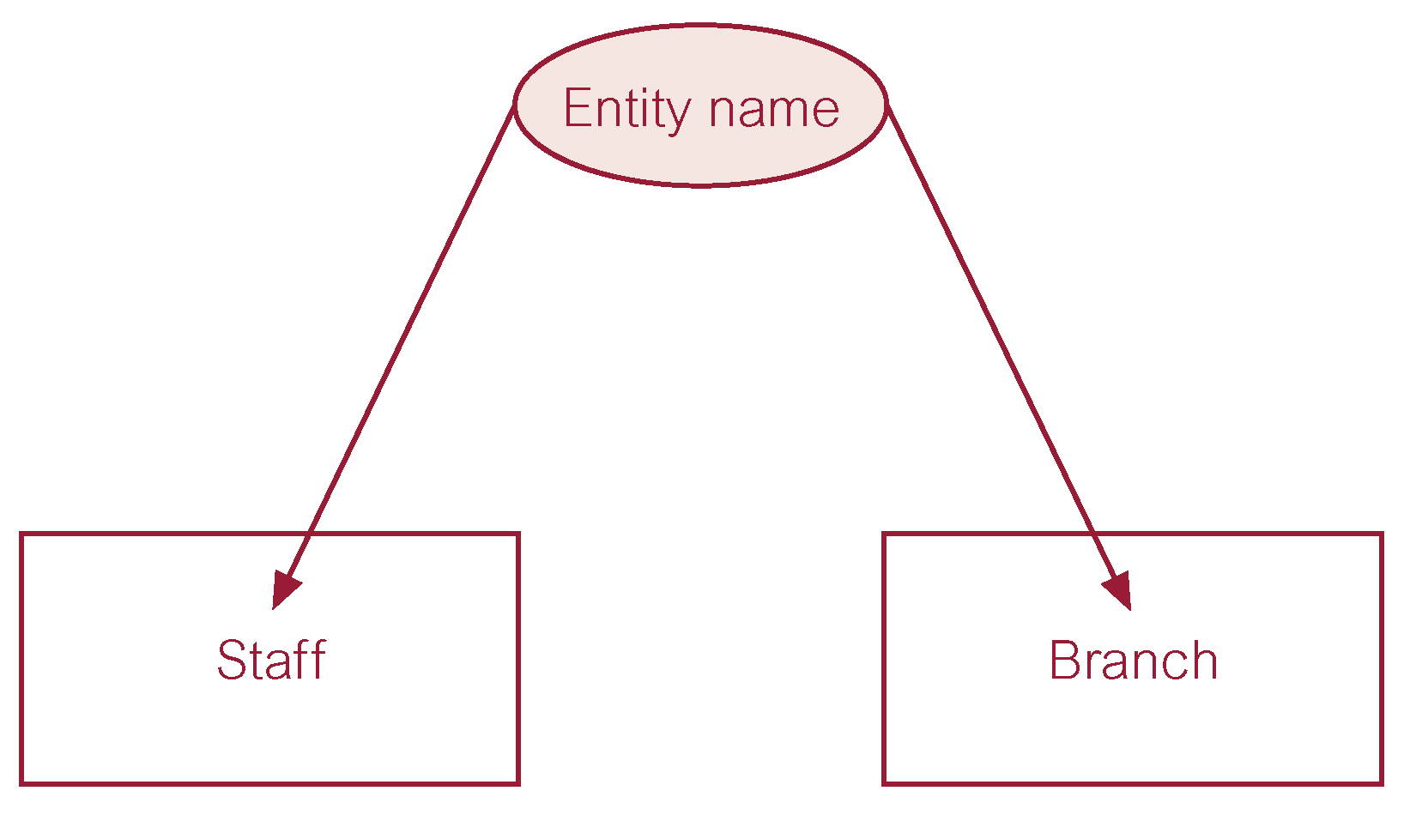
ER diagram of Staff and Branch entity types
Pearson Education © 2009

Slide 9
Relationship Types
Relationship type
Set of meaningful associations among entity types.
Relationship occurrence
Uniquely identifiable association, which includes one occurrence from each participating entity type.
Pearson Education © 2009

Slide 10
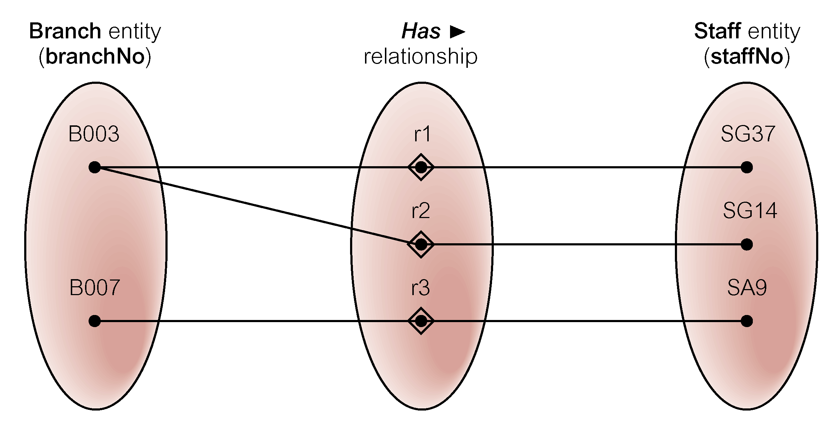
Semantic net of Has relationship type
Pearson Education © 2009

Slide 11
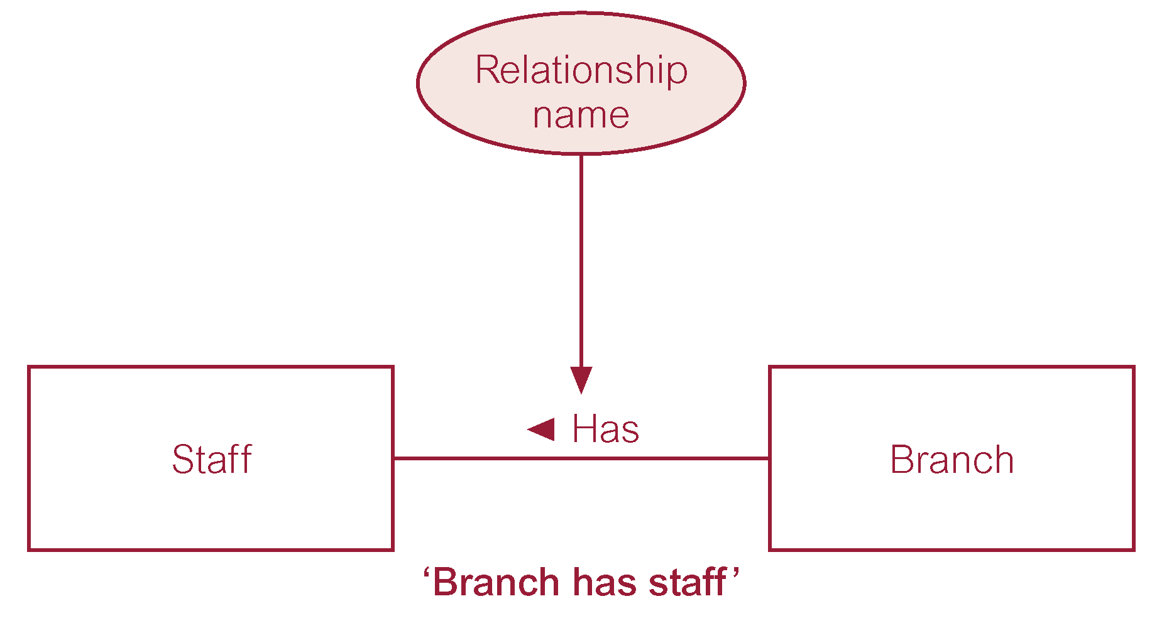
ER diagram of Branch Has Staff relationship
Pearson Education © 2009

Slide 12
Relationship Types
Degree of a Relationship
Number of participating entities in relationship.
Relationship of degree :
two is binary
three is ternary
four is quaternary.
Pearson Education © 2009

Slide 13

Binary relationship called POwns
Pearson Education © 2009

Slide 14
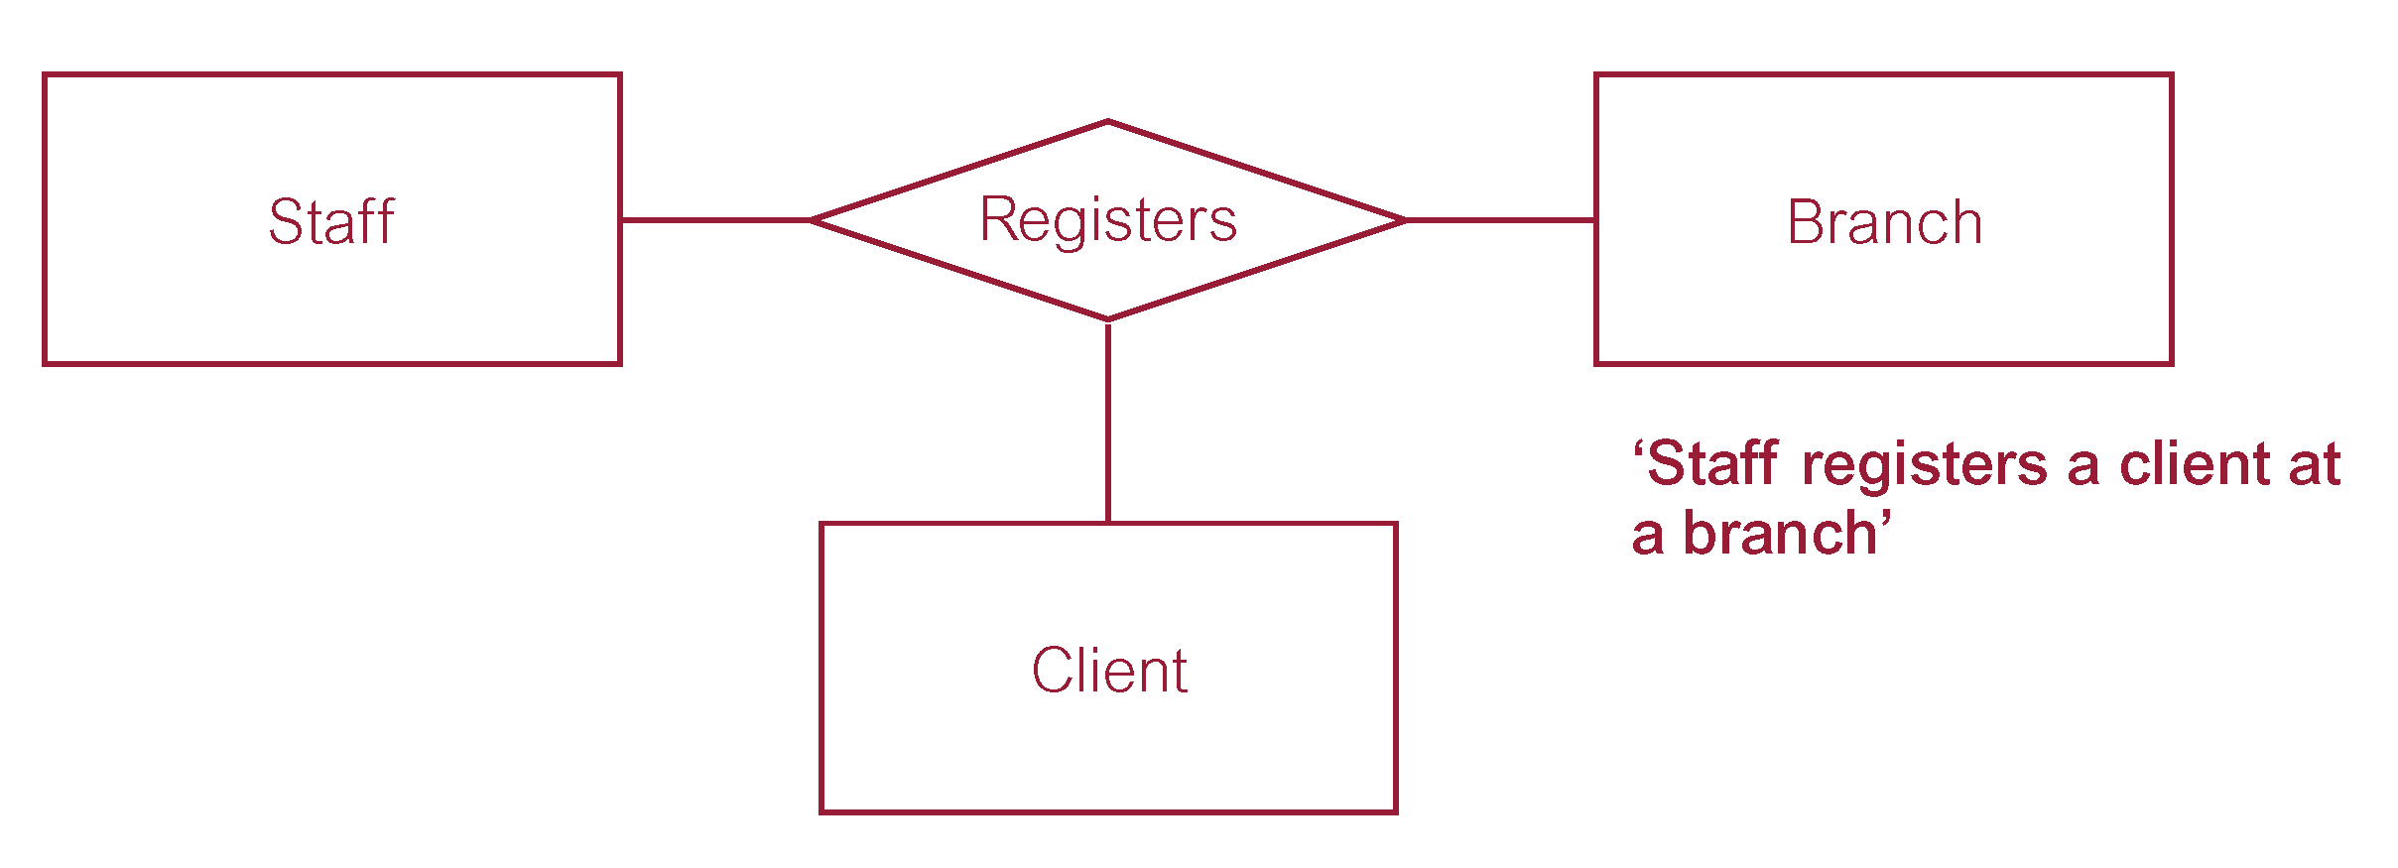
Ternary relationship called Registers
Pearson Education © 2009

Slide 15
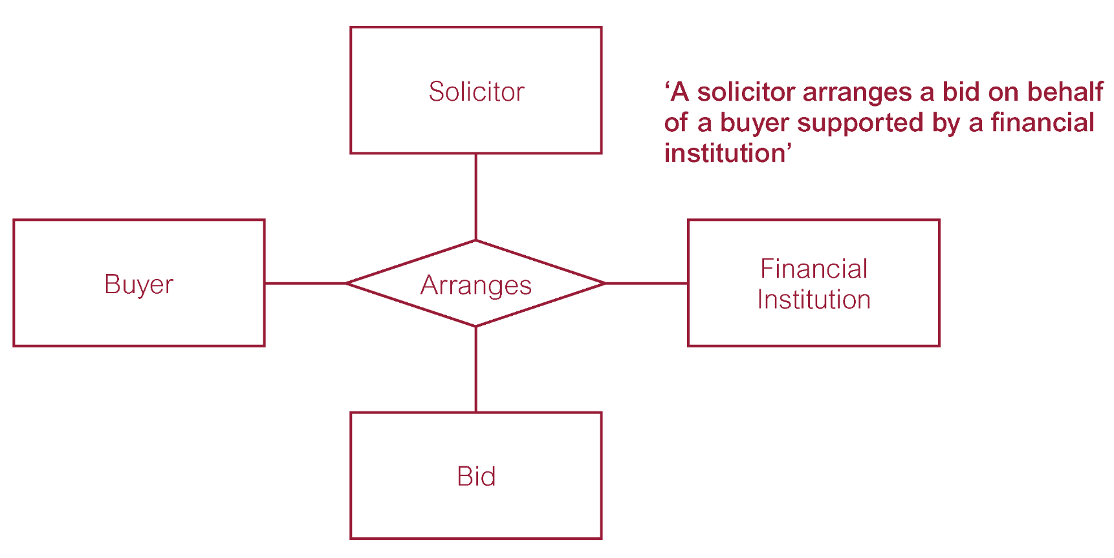
Quaternary relationship called Arranges
Pearson Education © 2009

Slide 16
Relationship Types
Recursive Relationship
Relationship type where same entity type participates more than once in different roles.
Relationships may be given role names to indicate purpose that each participating entity type plays in a relationship.
Pearson Education © 2009

Slide 17
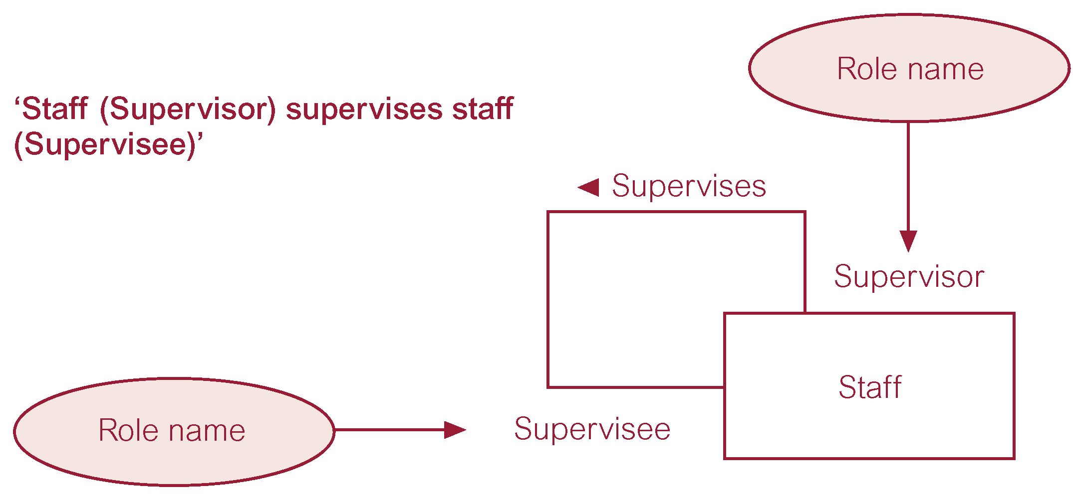
Recursive relationship called Supervises with role names
Pearson Education © 2009

Slide 18
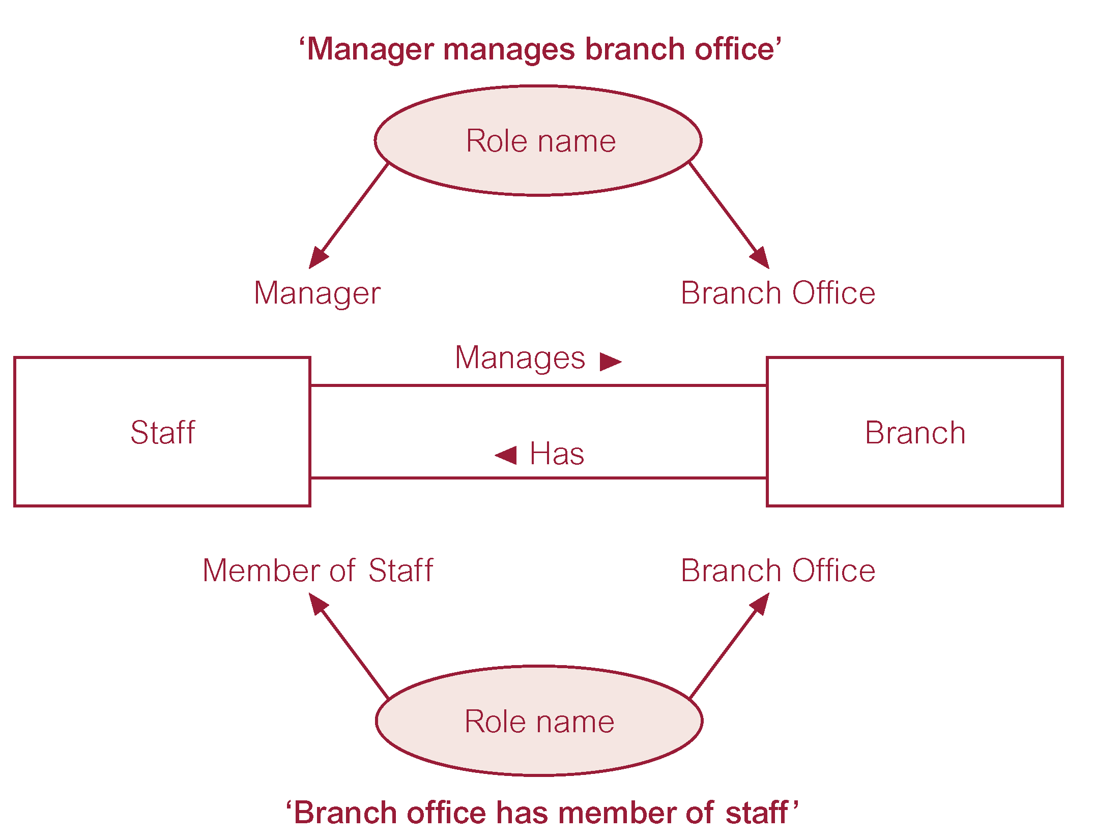
Entities associated through two distinct relationships with role names
Pearson Education © 2009

Slide 19
Attributes
Attribute
Property of an entity or a relationship type.
Attribute Domain
Set of allowable values for one or more attributes.
Pearson Education © 2009

Slide 20
Attributes
Simple Attribute
Attribute composed of a single component with an independent existence.
Composite Attribute
Attribute composed of multiple components, each with an independent existence.
Pearson Education © 2009

Slide 21
Attributes
Single-valued Attribute
Attribute that holds a single value for each occurrence of an entity type.
Multi-valued Attribute
Attribute that holds multiple values for each occurrence of an entity type.
Pearson Education © 2009

Slide 22
Attributes
Derived Attribute
Attribute that represents a value that is derivable from value of a related attribute, or set of attributes, not necessarily in the same entity type.
Pearson Education © 2009

Slide 23
Keys
Candidate Key
Minimal set of attributes that uniquely identifies each occurrence of an entity type.
Primary Key
Candidate key selected to uniquely identify each occurrence of an entity type.
Composite Key
A candidate key that consists of two or more attributes.
Pearson Education © 2009

Slide 24
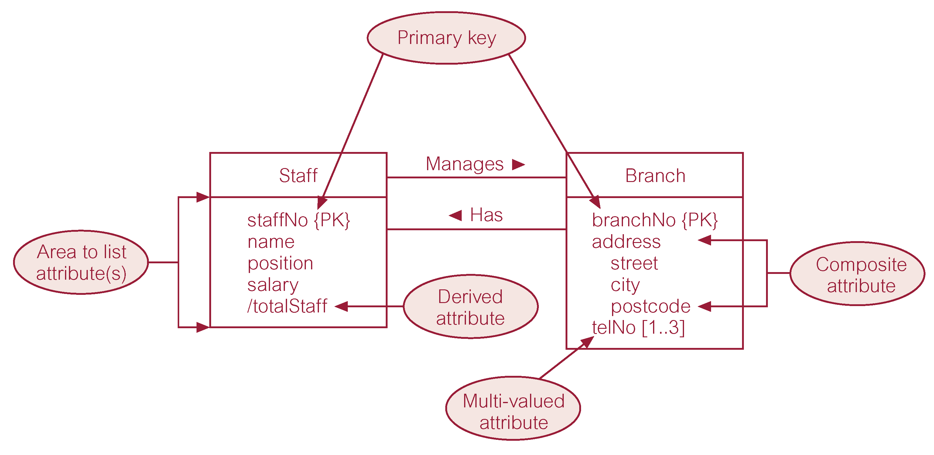
ER diagram of Staff and Branch entities and their attributes
Pearson Education © 2009

Slide 25
Entity Type
Strong Entity Type
Entity type that is not existence-dependent on some other entity type.
Weak Entity Type
Entity type that is existence-dependent on some other entity type.
Pearson Education © 2009

Slide 26
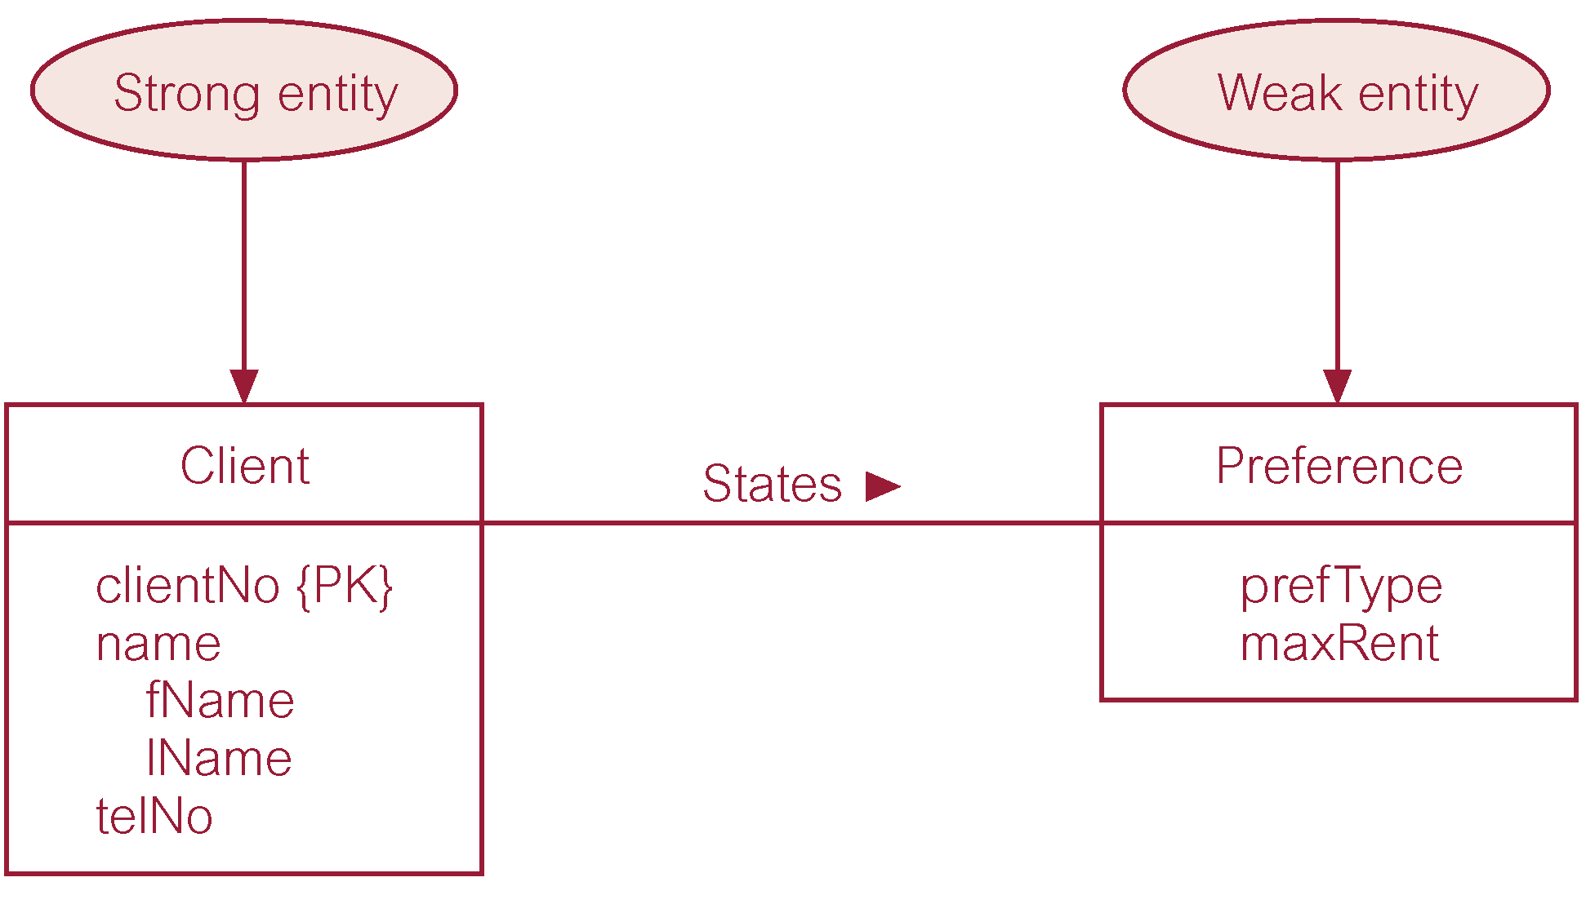
Strong entity type called Client and weak entity type called Preference
Pearson Education © 2009

Slide 27
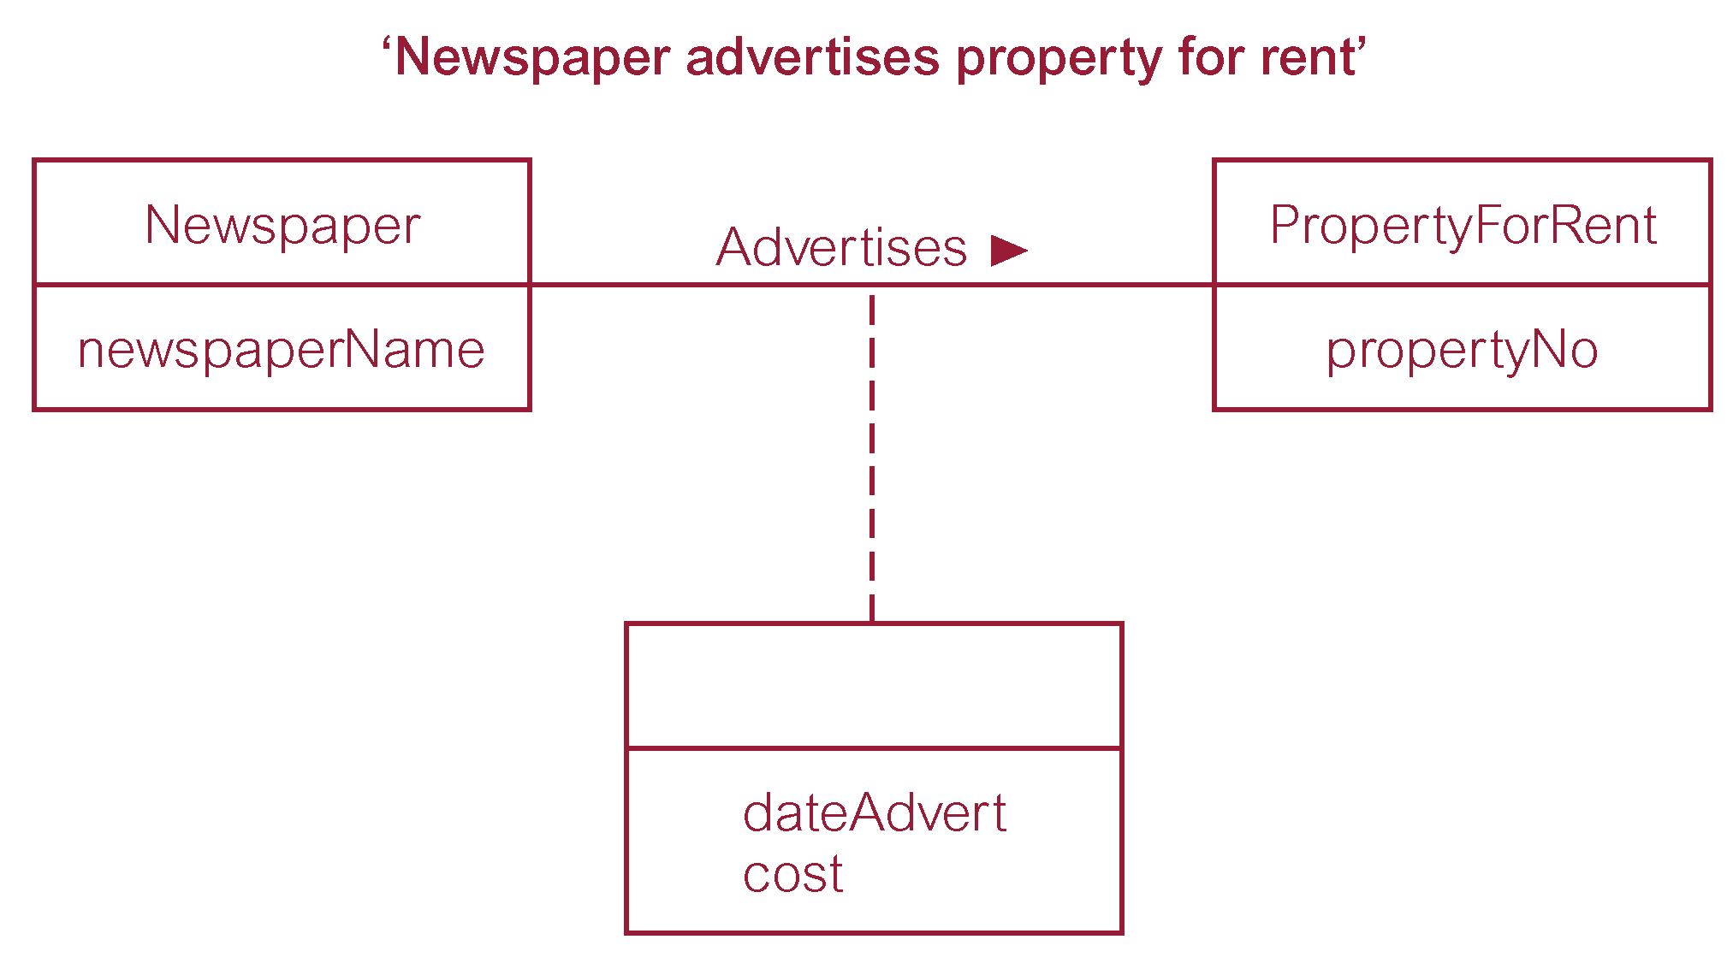
Relationship called Advertises with attributes
Pearson Education © 2009

Slide 28
Structural Constraints
Main type of constraint on relationships is called multiplicity.
Multiplicity - number (or range) of possible occurrences of an entity type that may relate to a single occurrence of an associated entity type through a particular relationship.
Represents policies (called business rules) established by user or company.
Pearson Education © 2009

Slide 29
Structural Constraints
The most common degree for relationships is binary.
Binary relationships are generally referred to as being:
one-to-one (1:1)
one-to-many (1:*)
many-to-many (*:*)
Pearson Education © 2009

Slide 30
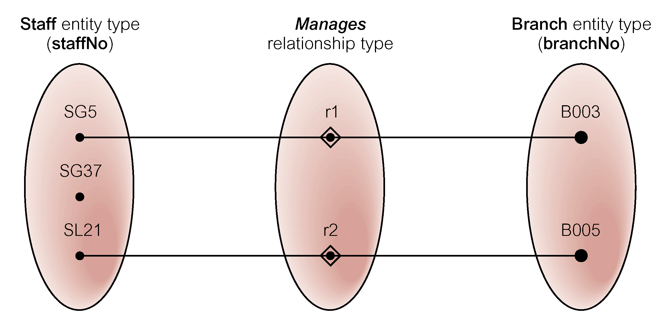
Semantic net of Staff Manages Branch relationship type
Pearson Education © 2009

Slide 31
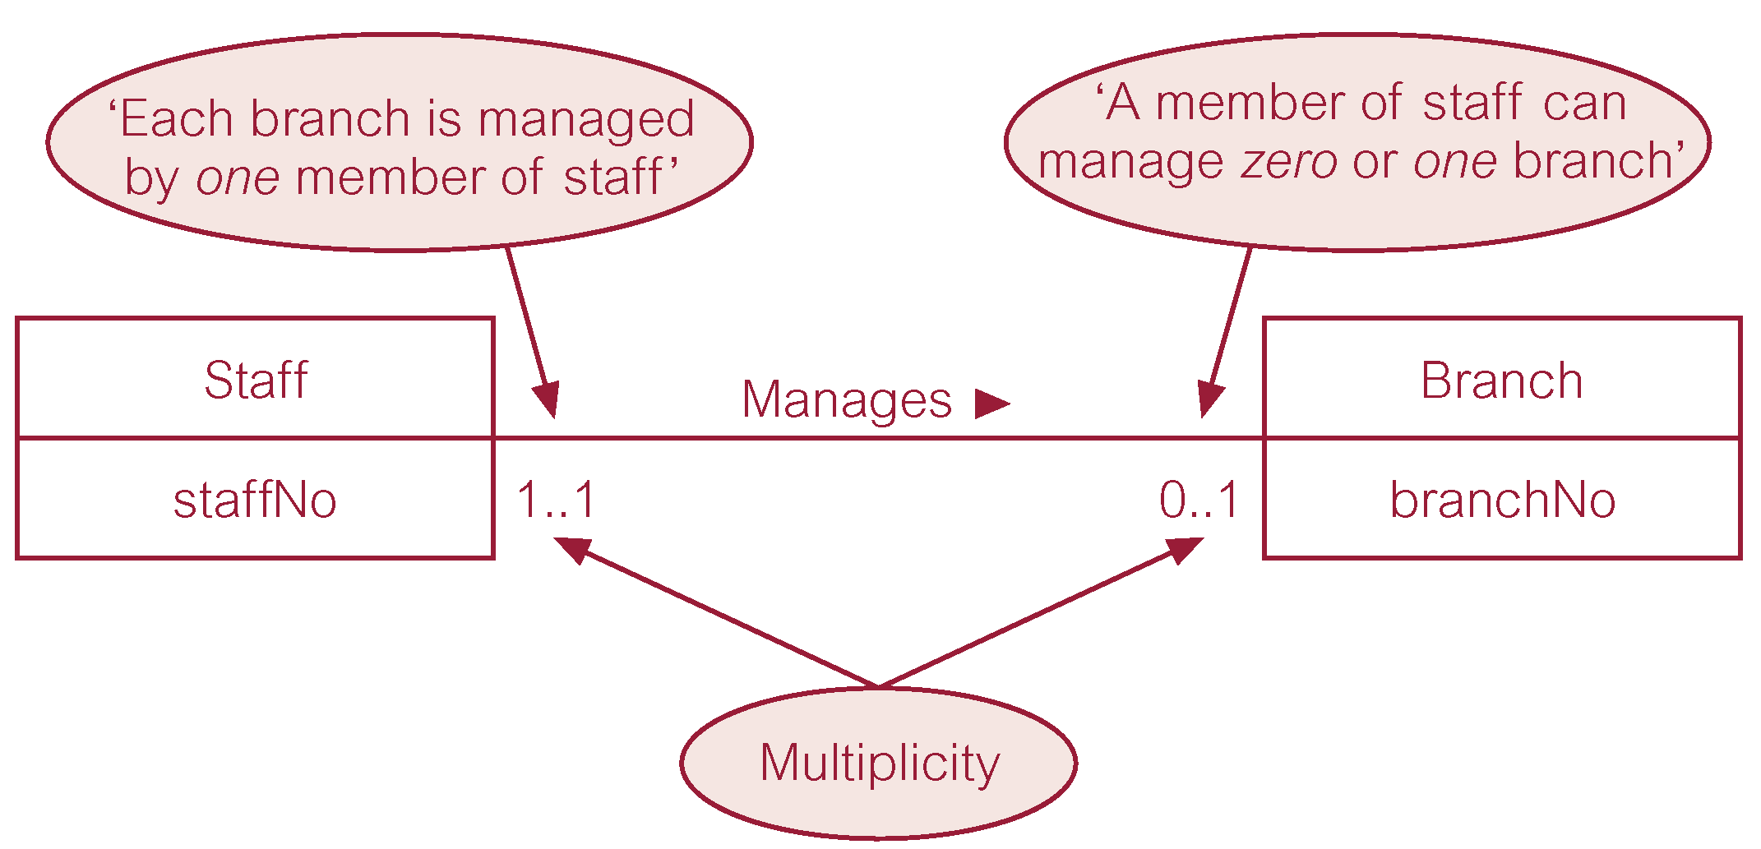
Multiplicity of Staff Manages Branch (1:1) relationship
Pearson Education © 2009

Slide 32
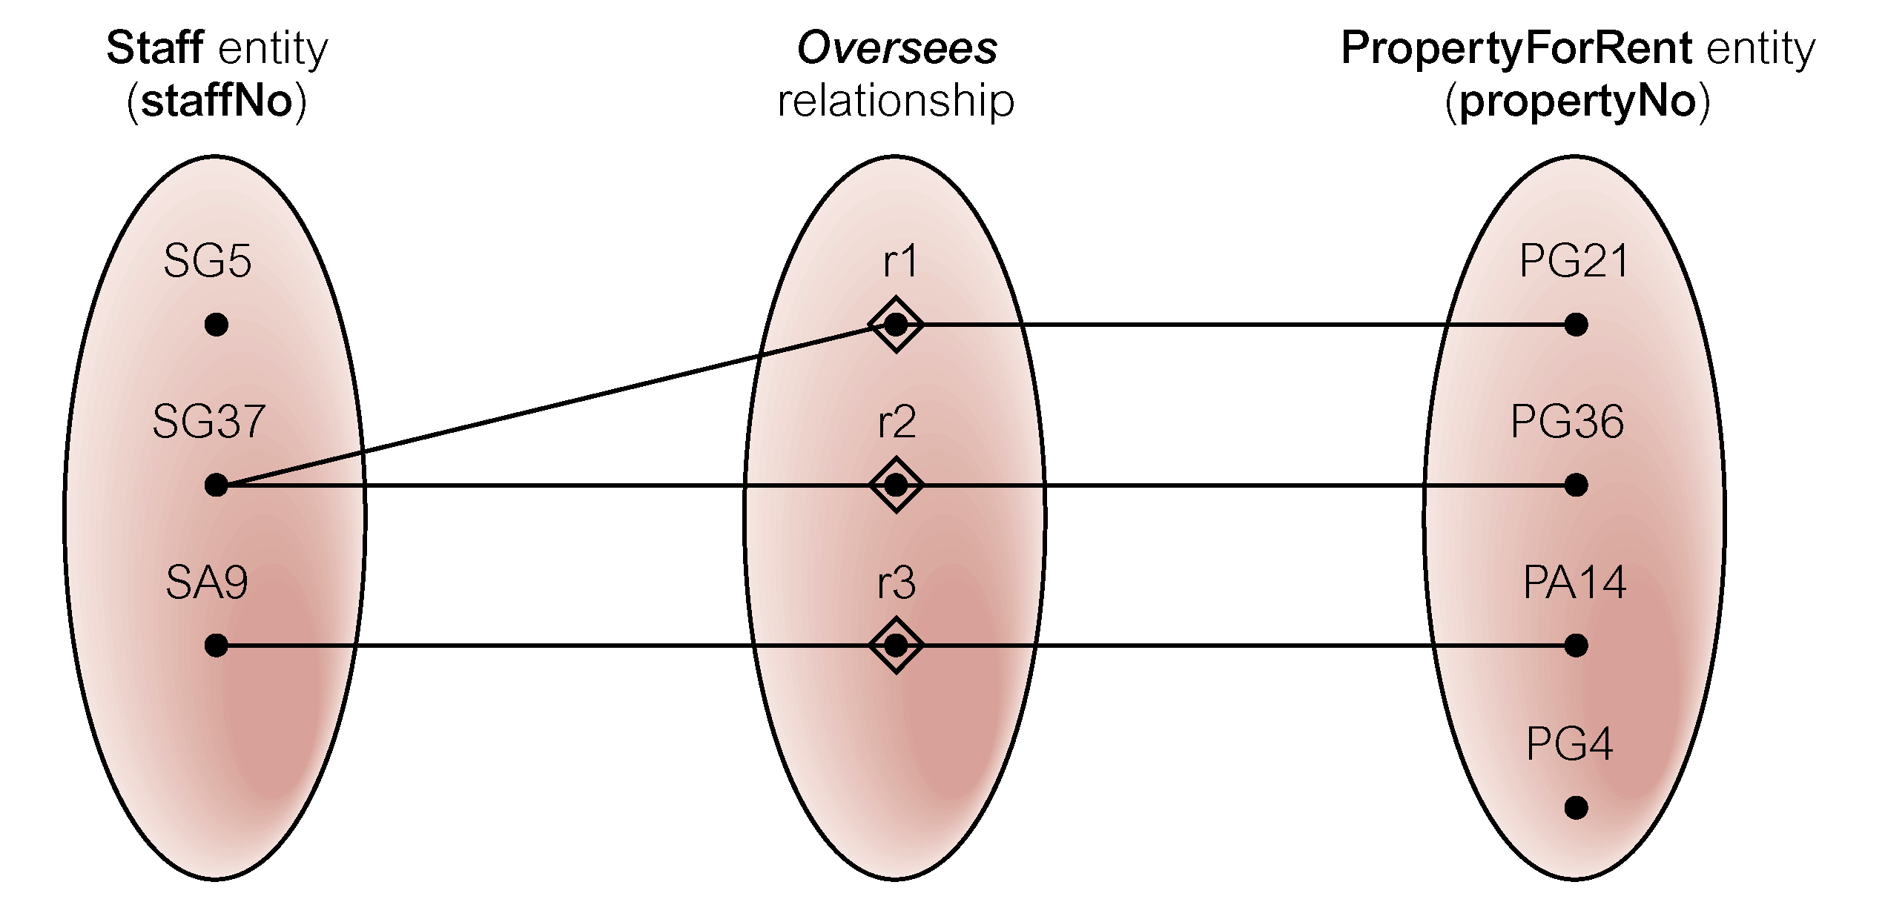
Semantic net of Staff Oversees PropertyForRent relationship type
Pearson Education © 2009

Slide 33
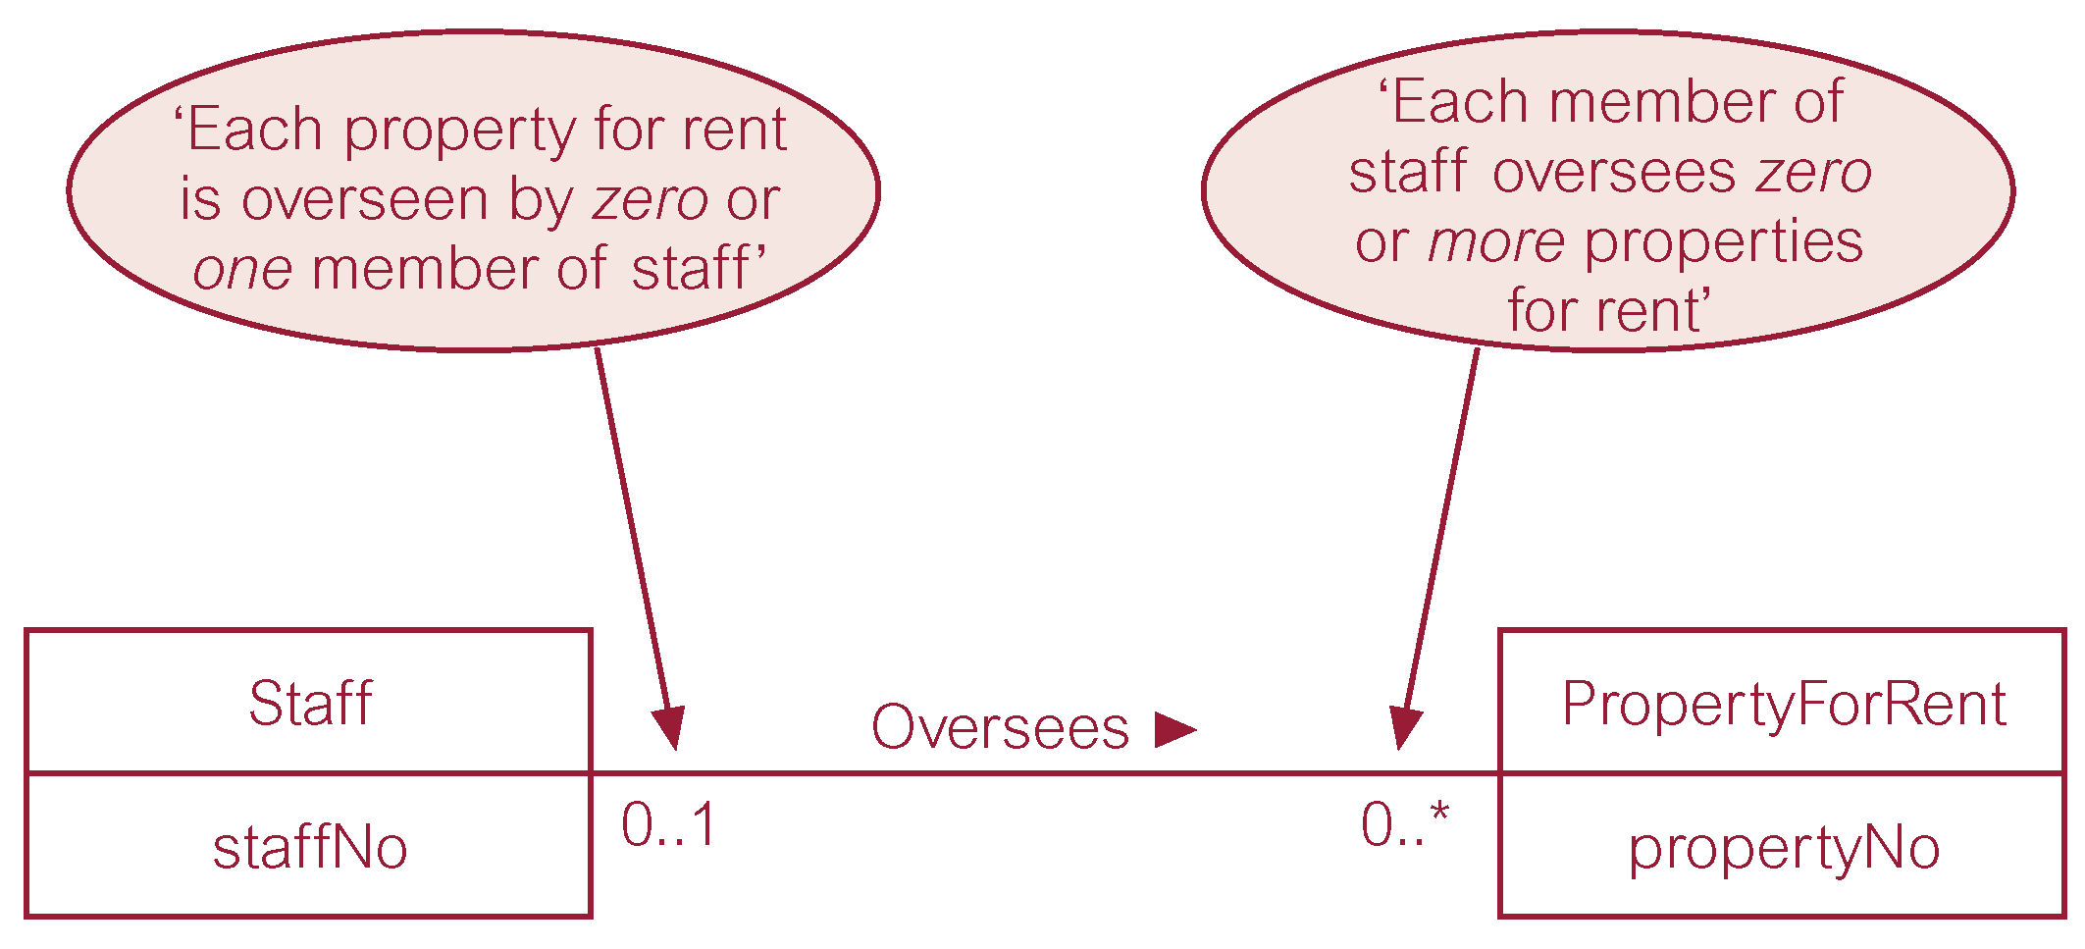
Multiplicity of Staff Oversees PropertyForRent (1:*) relationship type
Pearson Education © 2009

Slide 34
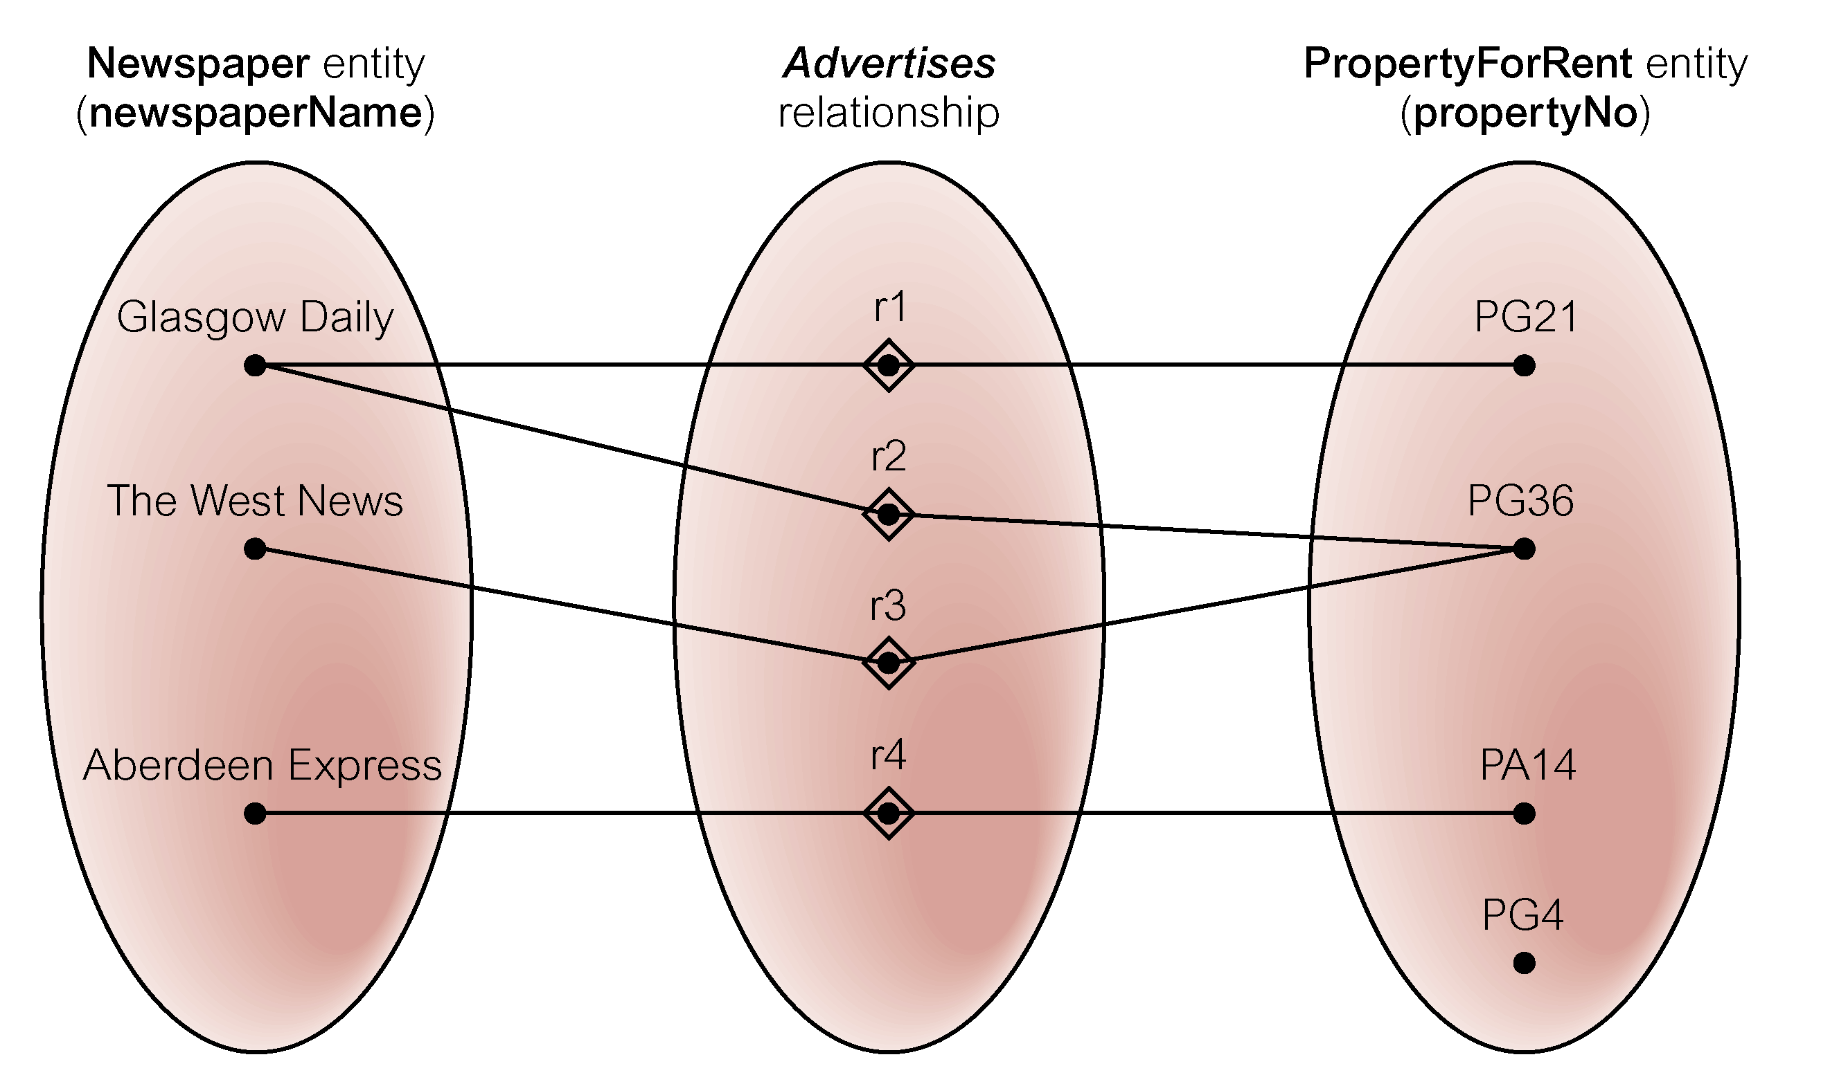
Semantic net of Newspaper Advertises PropertyForRent relationship type
Pearson Education © 2009

Slide 35
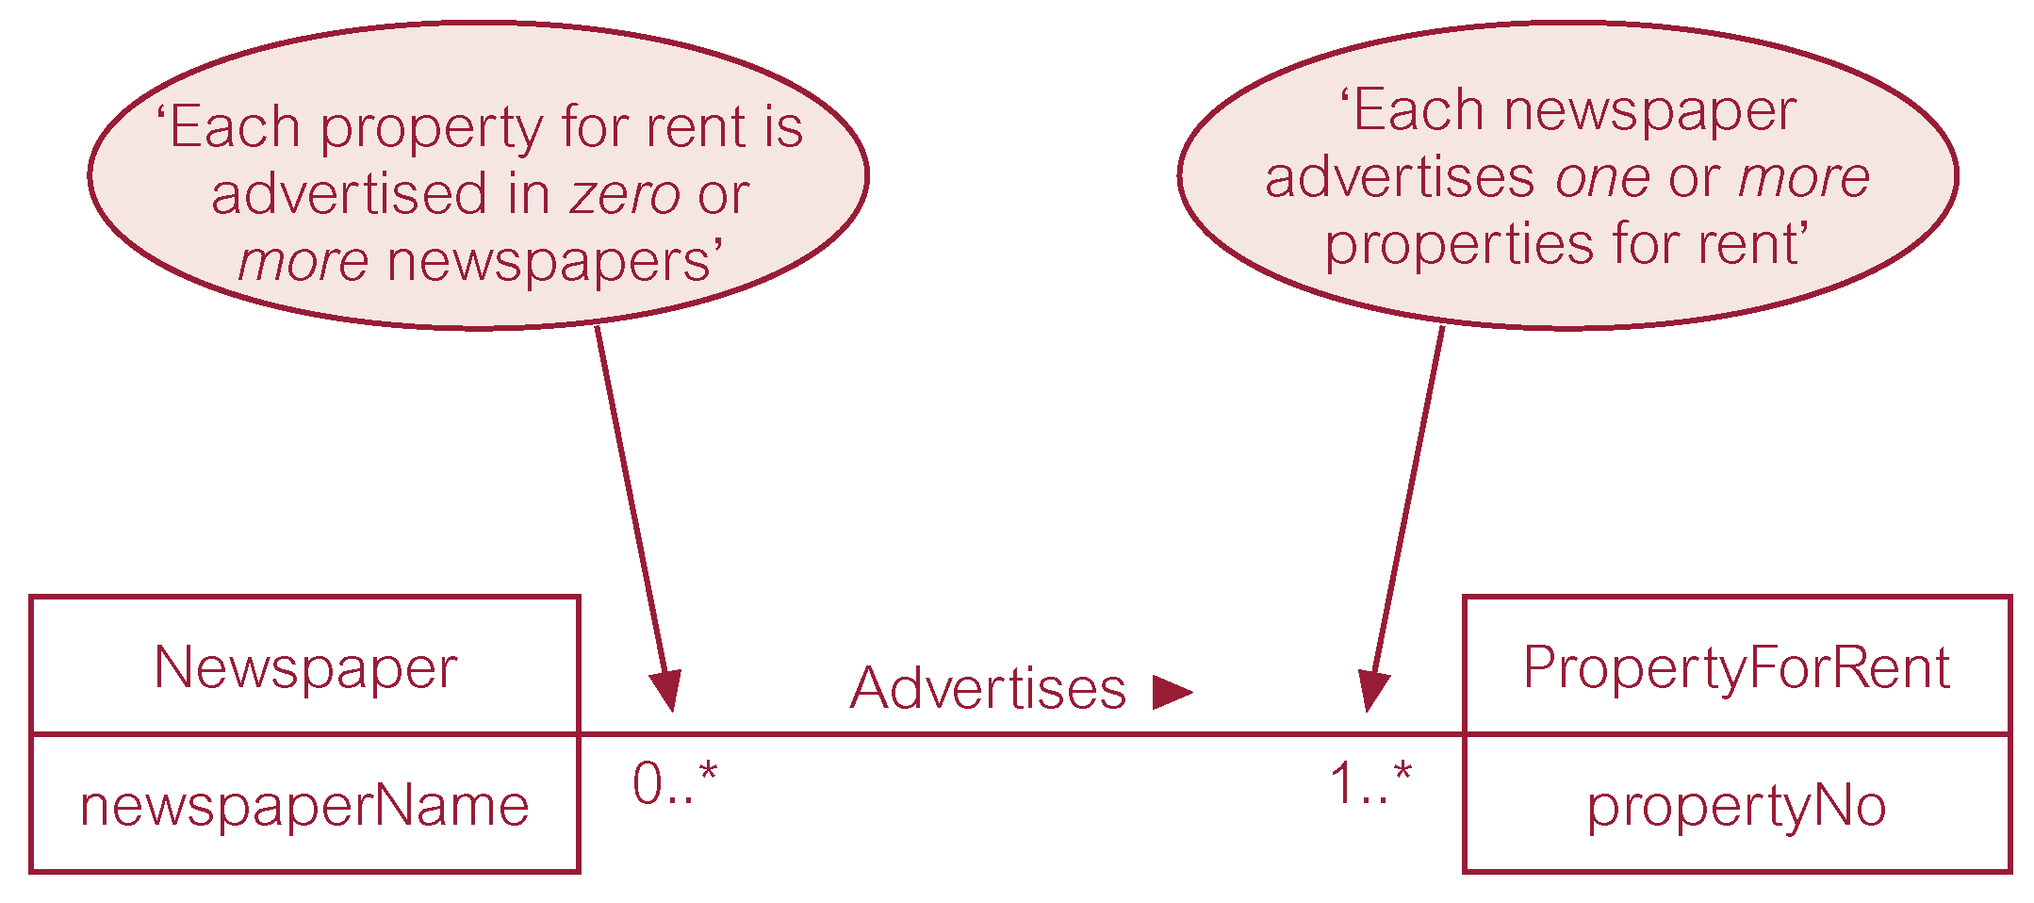
Multiplicity of Newspaper Advertises PropertyForRent (*:*) relationship
Pearson Education © 2009

Slide 36
Structural Constraints
Multiplicity for Complex Relationships
Number (or range) of possible occurrences of an entity type in an n-ary relationship when other (n-1) values are fixed.
Pearson Education © 2009

Slide 37
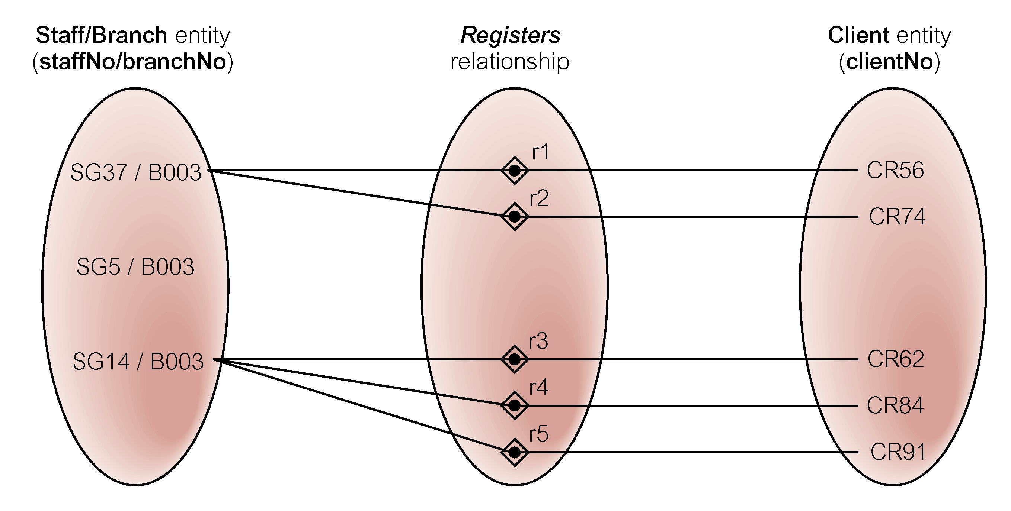
Semantic net of ternary Registers relationship with values for Staff and Branch entities fixed
Pearson Education © 2009

Slide 38
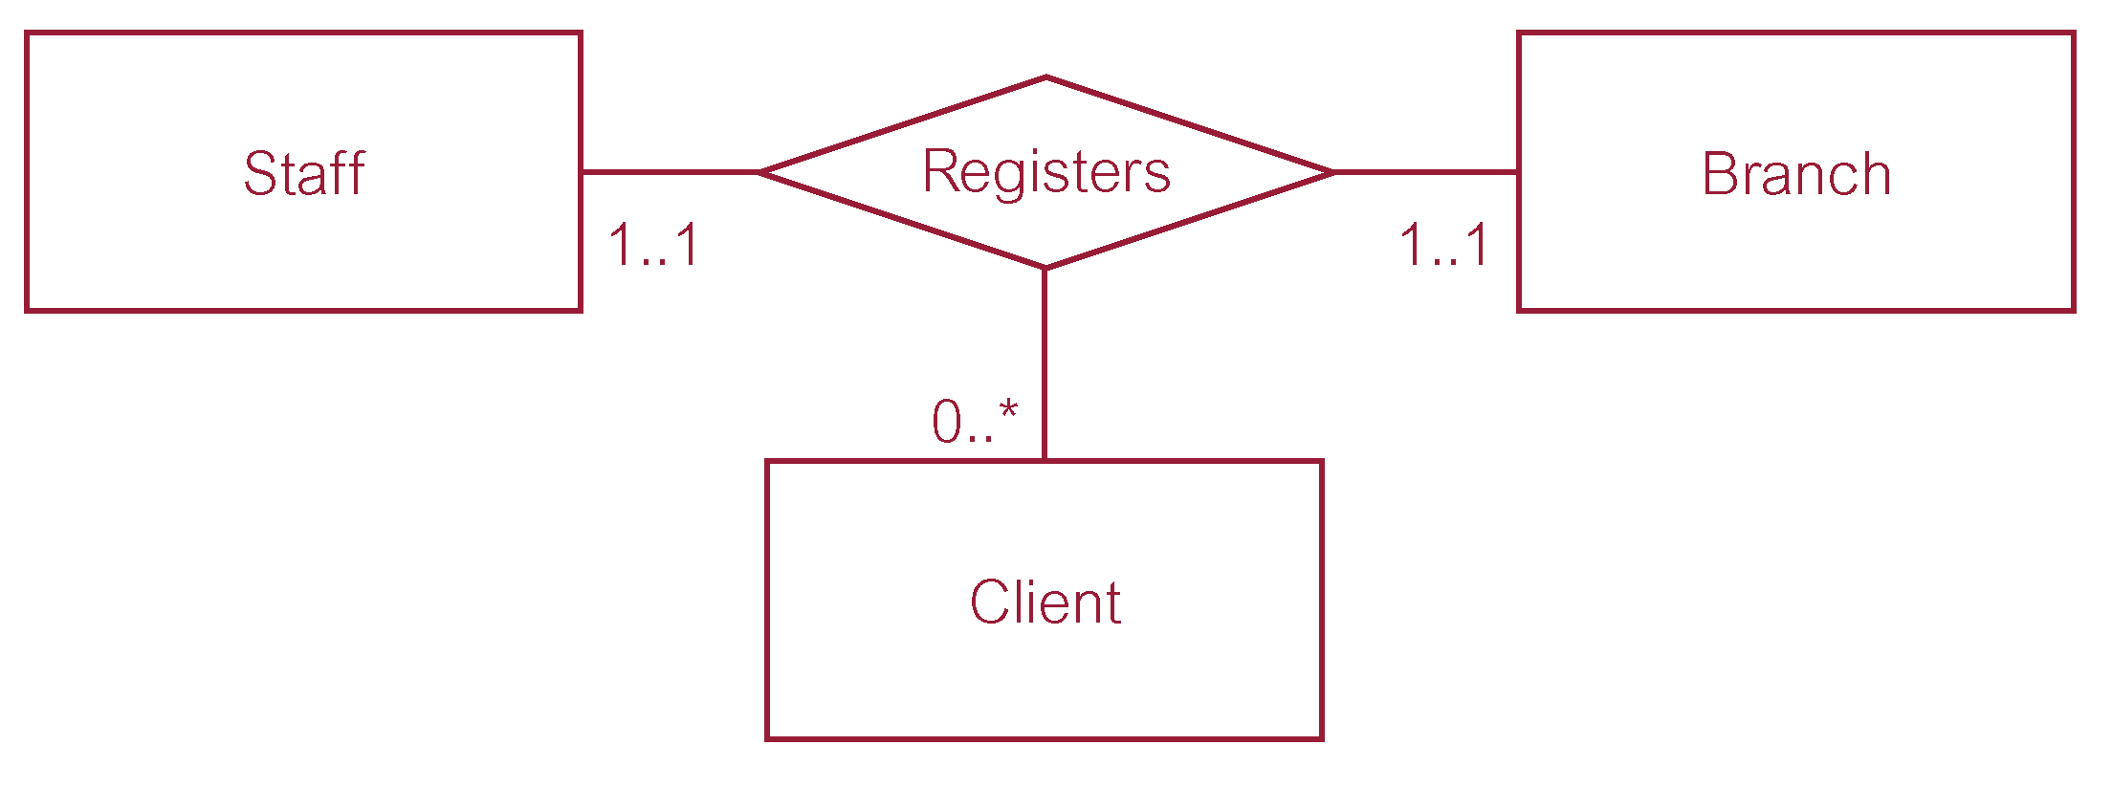
Multiplicity of ternary Registers relationship
Pearson Education © 2009

Slide 39
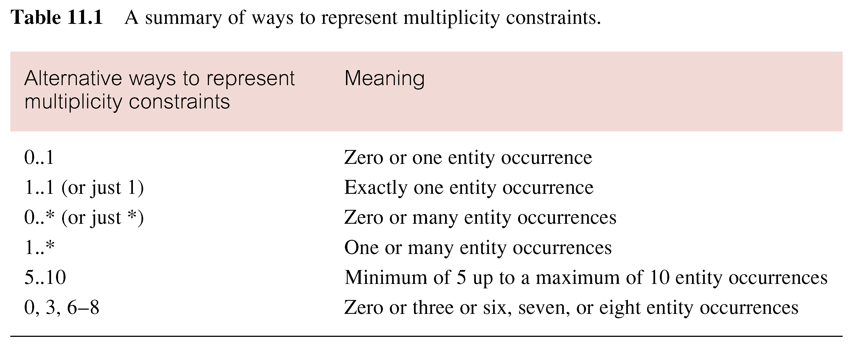
Summary of multiplicity constraints
Pearson Education © 2009

Slide 40
Structural Constraints
Multiplicity is made up of two types of restrictions on relationships: cardinality and participation.
Pearson Education © 2009

Slide 41
Structural Constraints
Cardinality
Describes maximum number of possible relationship occurrences for an entity participating in a given relationship type.
Participation
Determines whether all or only some entity occurrences participate in a relationship.
Pearson Education © 2009

Slide 42
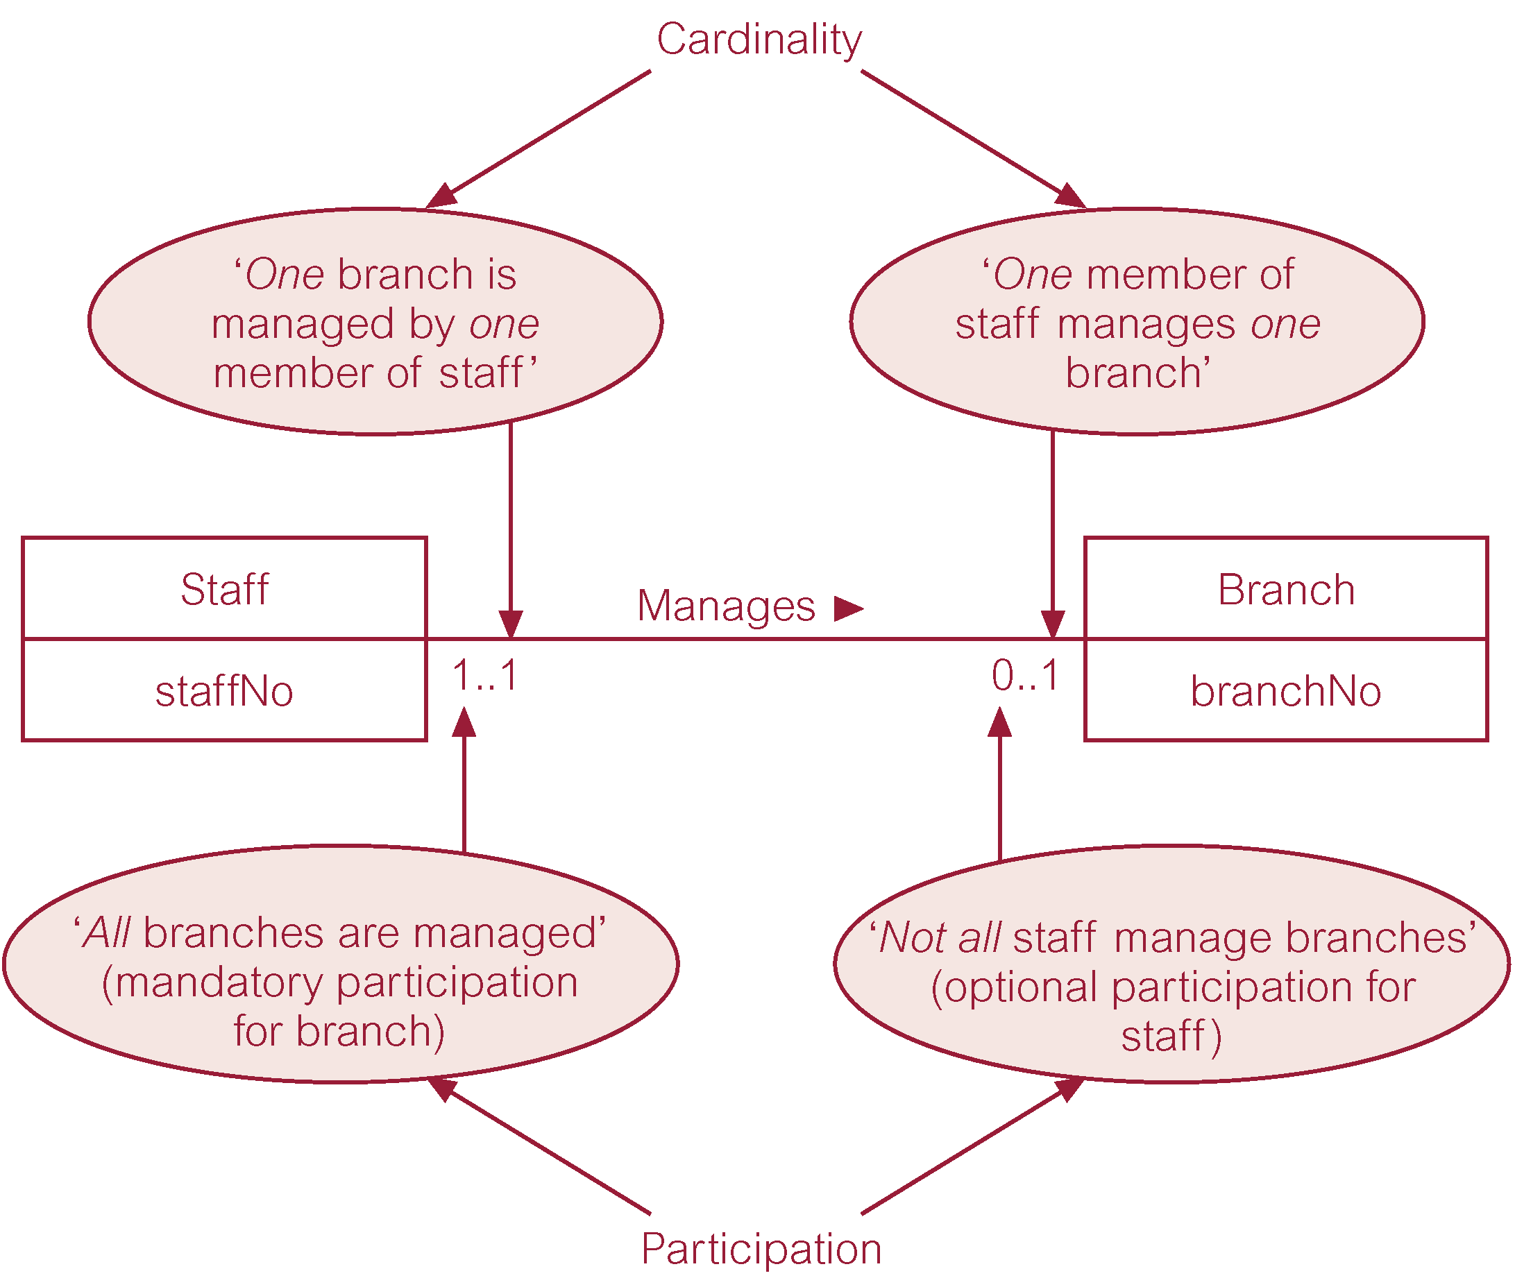
Multiplicity as cardinality and participation constraints
Pearson Education © 2009

Slide 43
Problems with ER Models
Problems may arise when designing a conceptual data model called connection traps.
Often due to a misinterpretation of the meaning of certain relationships.
Two main types of connection traps are called fan traps and chasm traps.
Pearson Education © 2009

Slide 44
Problems with ER Models
Fan Trap
Where a model represents a relationship between entity types, but pathway between certain entity occurrences is ambiguous.
Chasm Trap
Where a model suggests the existence of a relationship between entity types, but pathway does not exist between certain entity occurrences.
Pearson Education © 2009

Slide 45

An Example of a Fan Trap
Pearson Education © 2009

Slide 46
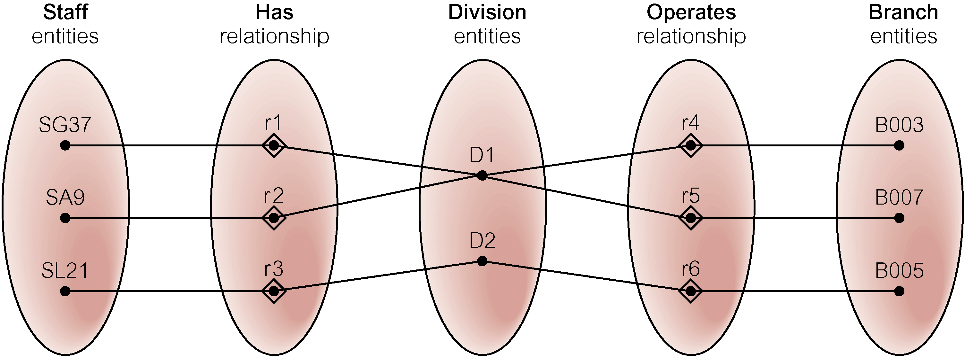
Semantic Net of ER Model with Fan Trap
At which branch office does staff number SG37 work?
Pearson Education © 2009

Slide 47
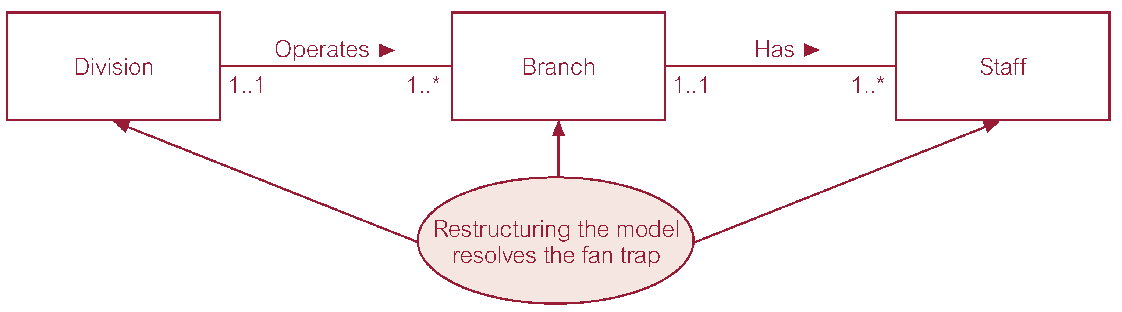
Restructuring ER model to remove Fan Trap
Pearson Education © 2009

Slide 48
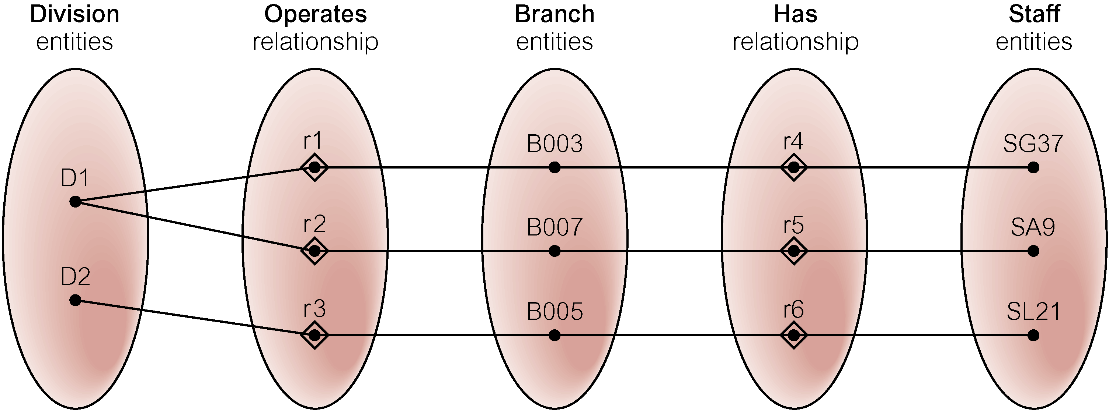
Semantic Net of Restructured ER Model with Fan Trap Removed
SG37 works at branch B003.
Pearson Education © 2009

Slide 49

An Example of a Chasm Trap
Pearson Education © 2009

Slide 50
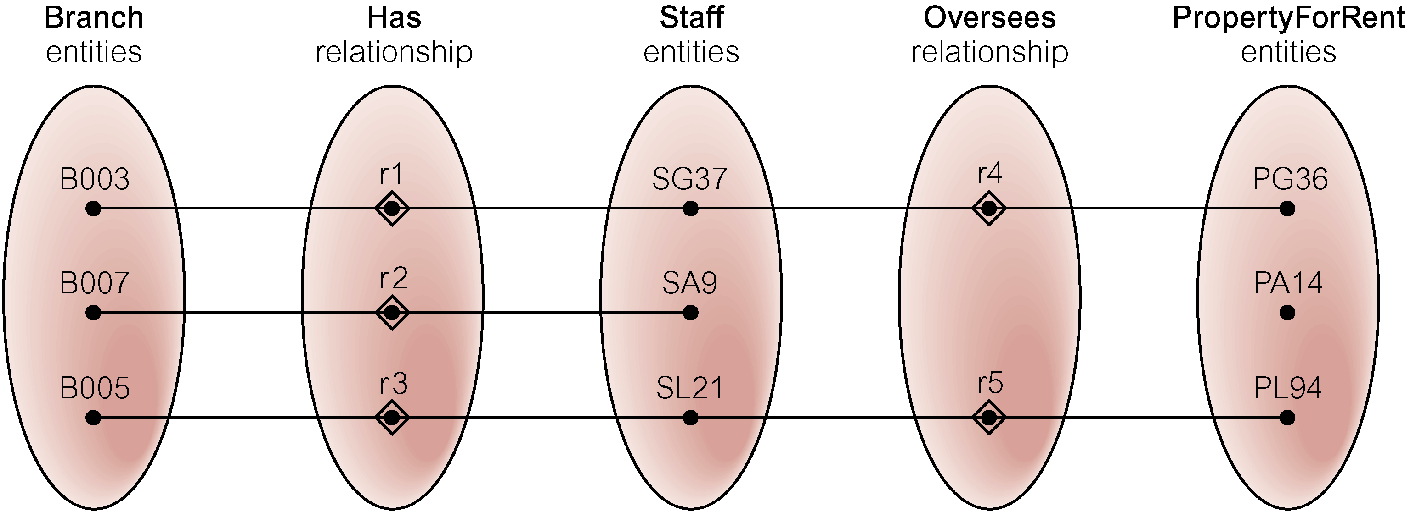
Semantic Net of ER Model with Chasm Trap
At which branch office is property PA14 available?
Pearson Education © 2009

Slide 51
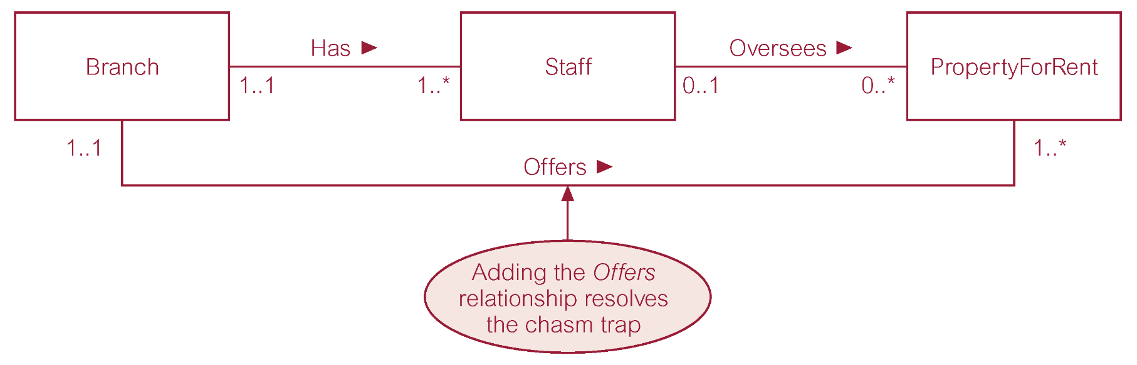
ER Model restructured to remove Chasm Trap
Pearson Education © 2009

Slide 52
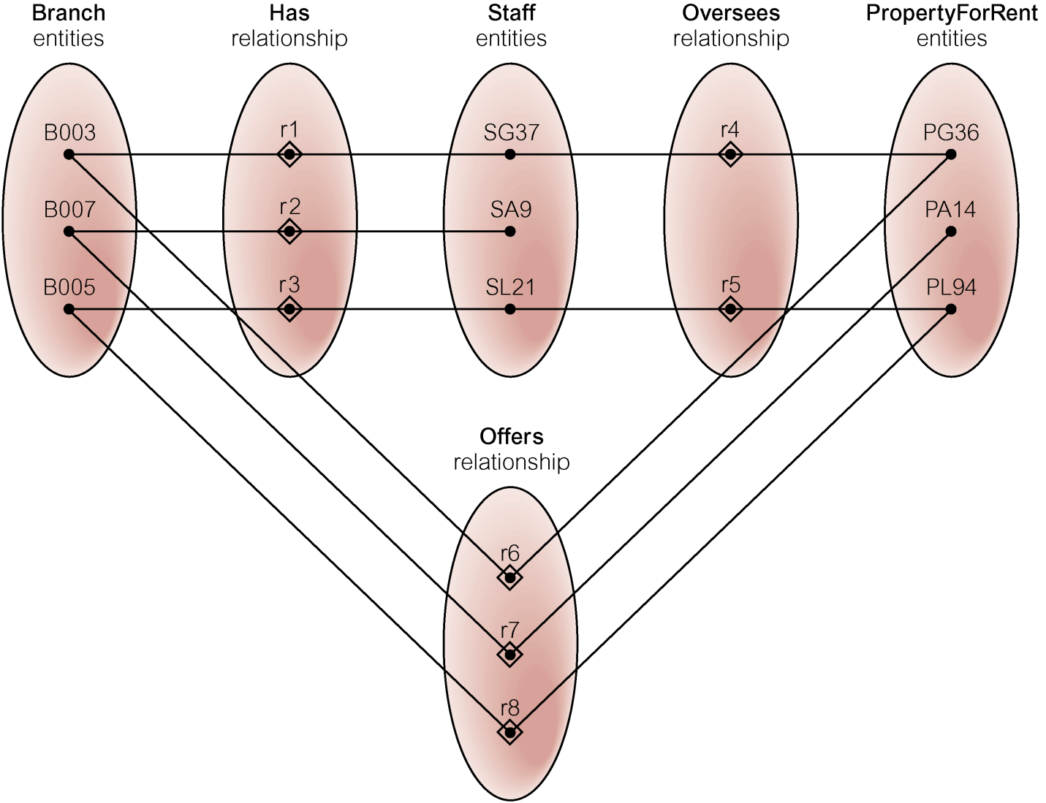
Semantic Net of Restructured ER Model with Chasm Trap Removed
Pearson Education © 2009

